Slide 1

Lecture – 10/11/2016
CSCI 36300 – Software Design

Slide 2
Feedback Session

Slide 3
Quiz #9

Slide 4
Command Pattern

Slide 5
Command Pattern
Coupling Constraints
Tightly Coupled?
If the request chosen by the client is more important than the identity of the receiver.
Goal:
The client should be able to issue a request for an operation and the “right” thing should just happen.

Slide 6
What is Coupling?
Coupling between classes is nothing but dependency of one class on another class.
Coupling is one of the factors to consider in improving a design.
Measures the strength of all relationships between functional units.
Tied closely with cohesion (Low → High).

Slide 7
What is Coupling?
Common forms of coupling are:
Class A has an attribute (data member or instance variable) that refers to a Class B instance, or Class B itself.
Class A has a method which references an instance of Class B, or Class B itself.
These typically include a parameter or local variable of type Class B, or the object returned from a message being an instance of Class B.
Class A is a direct, or indirect, subclass of Class B.
Class B is an interface, and Class A implements that interface.

Slide 8
Command Pattern
Role:
Lets you encapsulate actions, where each class has an execute method which is declared in the Command interface the class implements.
Pass those objects to an Invoker class which makes a callback to the execute method of each class at the appropriate time.

Slide 9
Command Pattern
Role:
Command Objects = Black Box
Execute method is known to be available but no information regarding the specific logic is known.
Commonly Found:
GUI’s
Menu Bars
Progress Bars
Parallel Processing
Event-based actions

Slide 10
Command Pattern
Structure:
Client issues a particular request to create the corresponding Command object.
When invoked, the command object initiates and controls the execution of the represented request.
This is done with respect to any arguments it receives when executed.

Slide 11
Command Pattern
Flow of Control:
The Client asks for a command to be executed.
The Invoker takes the command, encapsulates it and places it in a queue.
The ConcreteCommand that is in charge of the requested command performs the execution.
The result is then sent for to the Receiver.

Slide 12
Command Pattern
Consequences:
Lower Coupling
Decouples the requestor behavior from the recipient.
Reusability & Extendibility
Modifications to the receiver’s interface do not ripple through to its clients.
First Class Objects
It can be dynamically created, destroyed, passed to a function, returned as a value, and have all the rights as other variables in the programming language have.

Slide 13
Command Pattern
Consequences:
Indirection
Abstraction
Composition
We can piece together Commands to form Composed Commands
Time-Separation
Pre-packaged and ready to run.
Combine multiple different command objects uniformly behind a single interface, and executing them in a particular order.

Slide 14
(Abstract) Factory Pattern

Slide 15
Abstract Factory Pattern
Motivation:
Have a set of closely related objects that need to be created, but do not care on their concrete type.
Have a set of closely related objects that are in different classifications.
Analogy
How does a automobile plant produce different versions of a car part without having to change its entire manufacturing operation for each part?

Slide 16

Abstract Factory Pattern
Classification:
Creational Design Pattern
Problem:
Hide the implementation details from the client.
Solution:
Provide an interface for creating families of related or dependent objects without specifying their concrete classes.

Slide 17
Implementation
Create a factory object that can handle requests and create concrete products.
The factory instantiates a new concrete product and then returns to the client the newly created product.
This new created product is cast to an abstract product class.
The client can then consume the products as abstract products without being aware about their concrete implementation.

Slide 18
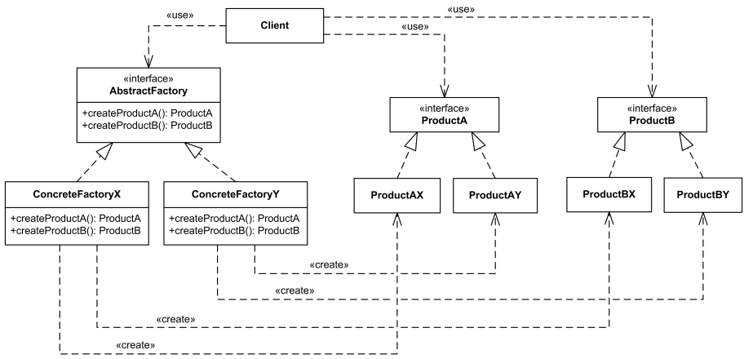
Abstract Factory Pattern

Slide 19
Abstract Factory Pattern
Usage
When a class cannot anticipate the class of objects it must create.
Or when you are unsure if similar classes will be added/removed.
When a class wants its subclasses to specify the objects it creates.
When you want a class to localize the knowledge of which helper subclass is the delegate.

Slide 20
Abstract Factory Pattern
Typically the most frequently used/applied pattern in OO languages.
Consequences
Isolates concrete classes.
Makes interchanging product families easy.
Promotes consistency.
Extendibility

